Slide 1
Tree Examples
Cosc 2430

Slide 2
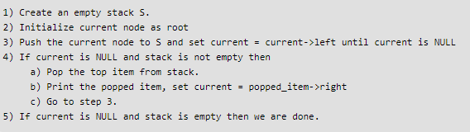
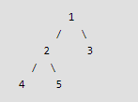
BST
Non-recursive In-order Traversal
Example:

Slide 3
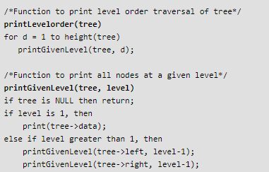
Binary Tree
Level Order Traversal

Slide 4
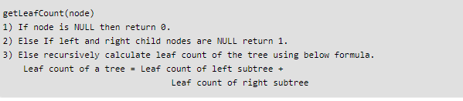
Binary Tree
# of leaf nodes in a binary tree

Slide 5
Which data structure?
Given a dictionary of words and a prefix, suggest
some words from the dictionary.
Dictionary ={ the, there, their, answer, bye, by, any,...}
For example,
th -> the, there, their

Slide 6
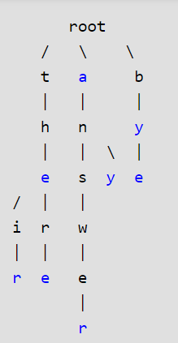
Trie
Given a dictionary of words and a prefix, suggest
some words from the dictionary.
Dictionary ={ the, there, their, answer, bye, by, any,...}
For example,
th -> the, there, their

Slide 7
Strings
Check whether two strings are anagram of each other
Write a function to check whether two given strings are anagram of each other or not. An anagram of a string is another string that contains same characters, only the order of characters can be different. For example, “abcd” and “dabc” are anagram of each other.
LISTEN and SILENT -> anagram

